Slide 1
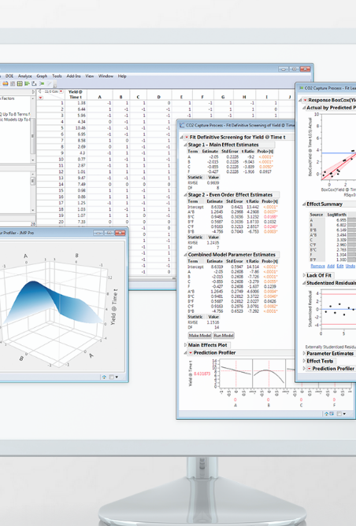
Tutorial – JMP, a SAS Software
Pronounced as “Jump”, JMP is a SAS built interactive statistical visualization and discovery tool.
Capabilities of JMP are:
Data exploration and display
Experiment design
Quality control
Qualitative analysis
Statistical modeling, Report building
Why use JMP?
Ease of use
Used in association with SAS. Allows for easy visualization even without enough knowledge of statistical complexities.
Can be used without training or prior programming knowledge
Point and click interface
Link to learn more about JMP : http://www.jmp.com/en_us/software/data-analysis-software.html

Slide 2


Airbnb: New user Bookings
Priyanka G Kalmane - BSAN

Slide 3
Challenge
Airbnb is a homestay network that enables travelers find affordable, convenient accommodation via a online marketplace.
Airbnb wants us to predict in which possible 5 countries a specific new user will make his/her booking.
With this, Airbnb can build a more personalized online experience for the new user. Also, better forecast demand.

Slide 4
Data
Number of observations – 213451 in Training Data Set
Train and Test – User Information
Sessions
Gender
Age
Date of the account created
Date of First booking
Sign up device
Sign up app
Browser used
Language
Kind of marketing
Marketing provider
Country Destination (train)
User id
Device type
Seconds elapsed
Action
Action type
Action detail

Slide 5
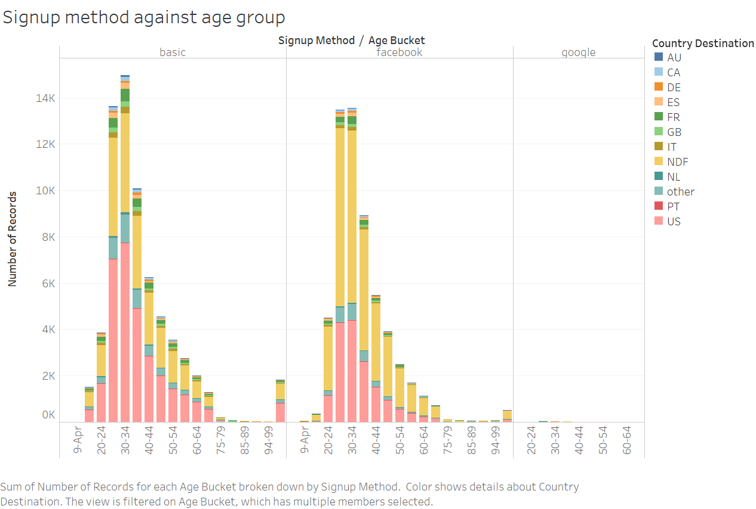
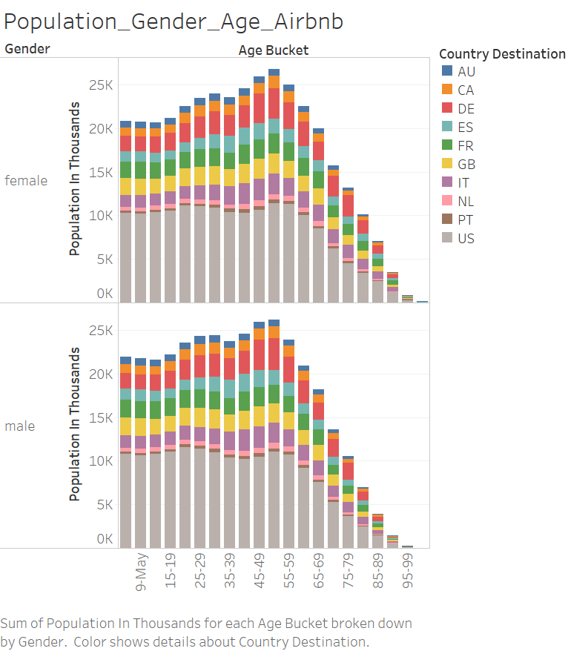
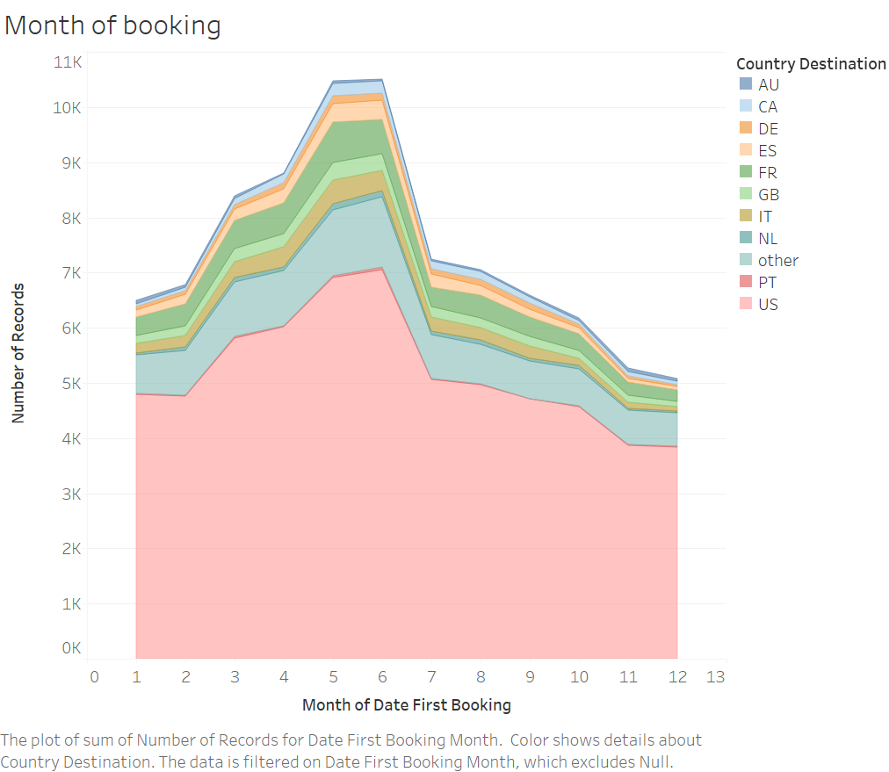
Intuition and next steps
Age, Gender, Month of booking, Language , Signup app, Device types seem to play a major role in deciding the country destination.
Seconds elapsed and the number of times a user has logged on plays a role in deciding upon the destination.
Next steps :
Identify relations
Classify users
Understand the patterns

Slide 6
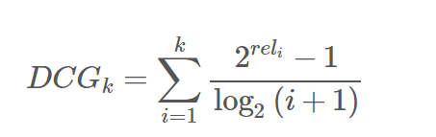
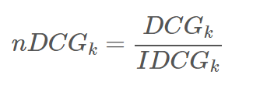
Modeling
3 models
Naïve Bayes – Each input variable is independent. Accuracy : 25.17%
Random forest – A bootstrap aggregation algorithm, multiple decision trees create models making prediction for the new data. These predictions are averaged to give a better estimate of the true output value. Accuracy : 45.048%
Extreme Gradient Boosting – Contains linear model solver and tree learning algorithms. Accuracy: 84.94%
Reason for the choice of models
Naïve Bayes – Simple probabilistic model to obtain conditional probability for each class.
Random forest – Experiment with a bagging algorithm to get a higher accuracy.
Extreme Gradient Boosting – Experiment with a boosting algorithm for a much higher accuracy
Feature Engineering
Age, Gender, Month of first booking, Device type, Language, Signup app
Evaluation Criteria
Normalized Discounted Cumulative Gain

Slide 7
Conclusions
Learnings from the Challenge
Different types of machine learning algorithms.
Naïve Bayes - Not the best model for real world data.
Random forest algorithm – A powerful ensemble bagging machine learning algorithm where suboptimal splits are made by introducing randomness.
Extreme Gradient Boosting – Strong boosting algorithm that works only with numeric data type. Used evaluation criteria Normalized Discounted Cumulative Gain.
Importance of optimization of Evaluation Criteria
What more could we do?
For higher accuracy, outliers in ‘Age’ could be recoded.
Could use multiple layers of algorithms such as Neural networks over Random Forest and Extreme Gradient Boost as the final layer for better accuracy.

Slide 8
Thank you!

